Slide 1
The Post-Corona Post
Main EDA question
Case 2 EDA
Where does parcel demand occur,
how is it served today,
and where do distance or capacity
pressures appear?
Maastricht Parcel Network
Demand, service point usage, geography, demographics, distance, and early cost/capacity pressure
1.35M
64.3%
35
From “Maastricht 2025” workbook: daily activity, service point locations, CBS squares, nodes, and road network edges.
annual parcel movements
pickup share
service points
482k home deliveries and 869k pickups in 2025
Pickups dominate total demand; delivery share is 35.7%
Locations are matched to CBS demand squares and distance
Milestone EDA overview
EDA flow
demand → geography → distance → pickup/delivery split → capacity pressure

Slide 2
EDA based on:
Separate workstreams, one connected modelling pipeline
1
Daily demand
2
Service point activity
3
Geography
Time trends and weekday patterns
Ranking and pickup/delivery ratios
Service point map and underserved areas
4
CBS demographics
5
Road network distance
6
Cost/capacity
Demand potential and missing values
Nearest service point and accessibility
Cost estimate and bounce-risk indicators
Combined EDA flow: demand -> geography -> distance -> pickup/delivery split -> cost/capacity -> optimization

Slide 3
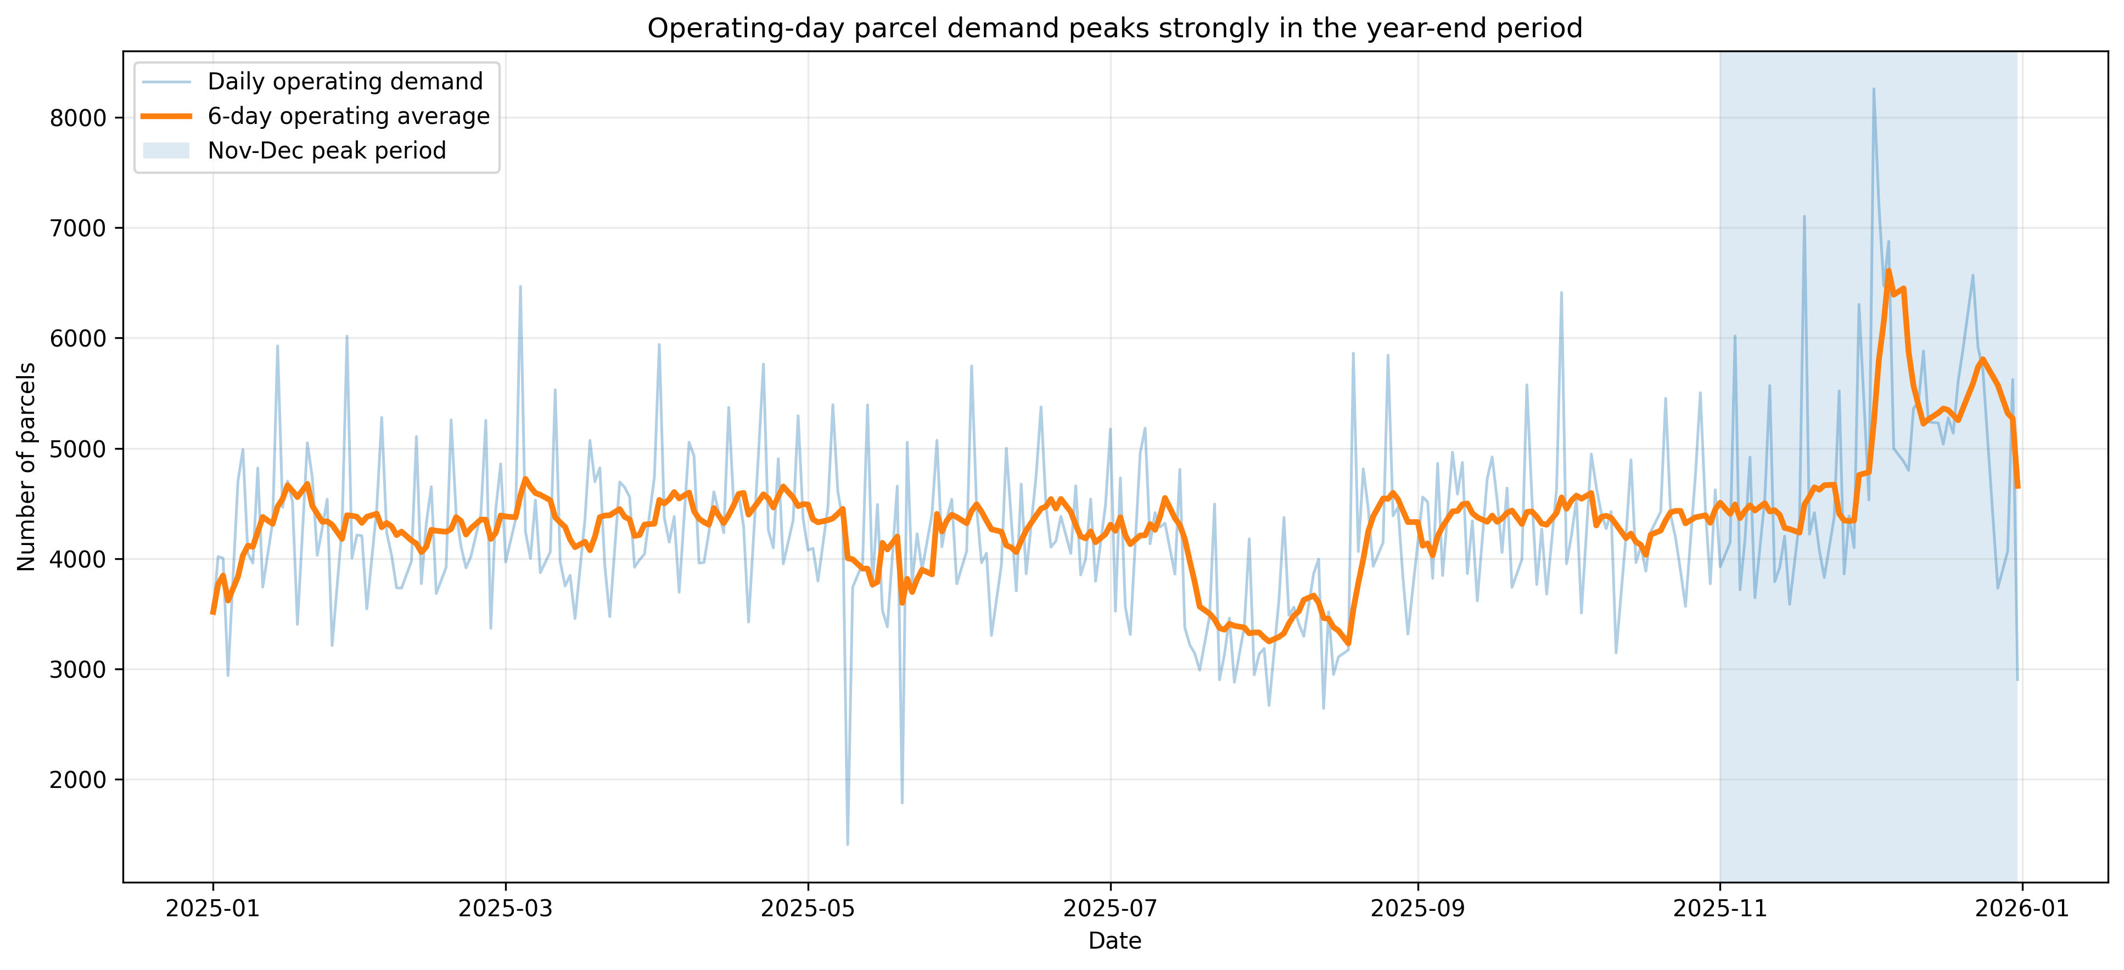
1. Maastricht generates high, pickup-heavy parcel demand
Demand baseline from observed 2025 Daily Activity
Total demand
Deliveries
Pickups
Average day
1,351,852
482,442
869,410
4,345
parcels in 2025
35.7% of activity
64.3% of activity
parcel movements
Pickups already dominate the current network.
Total activity is stable enough to use average-day benchmarks.
Daily peaks still matter for capacity and bounce risk.

Slide 4
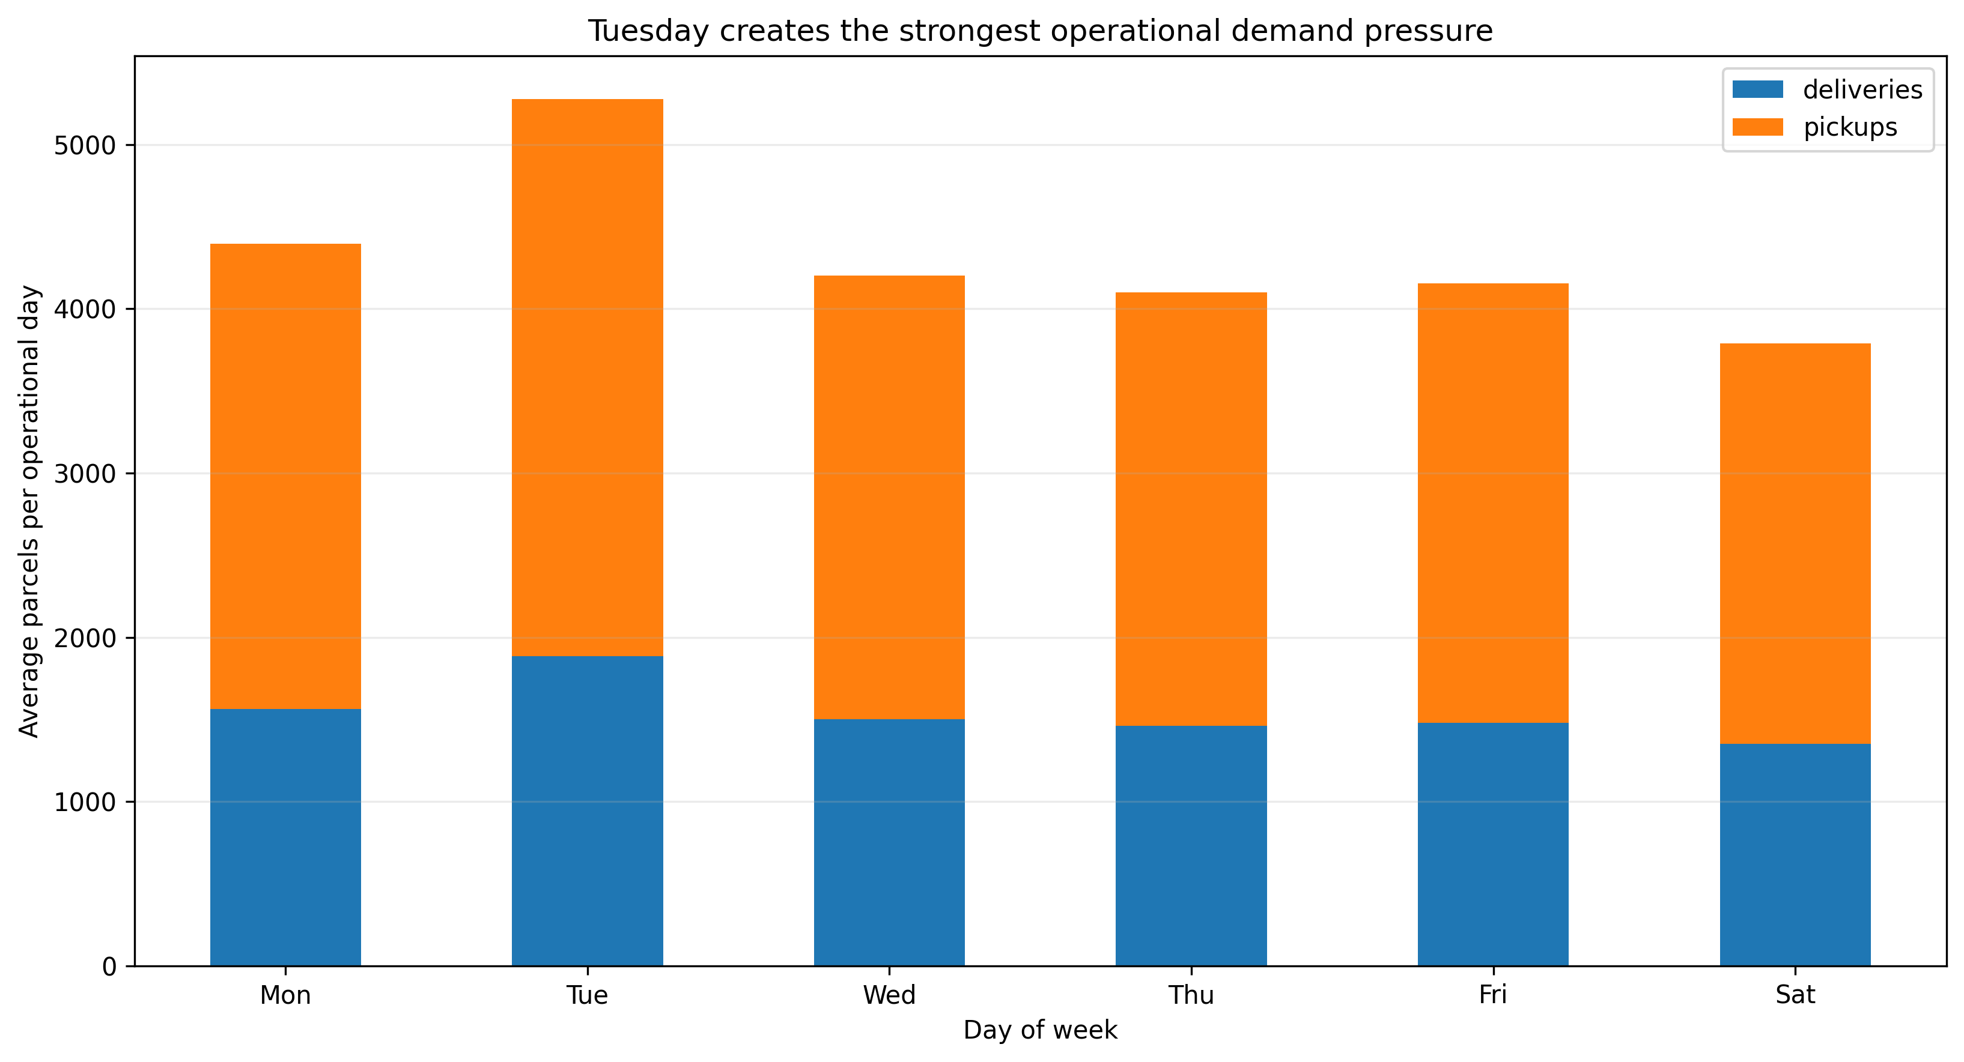
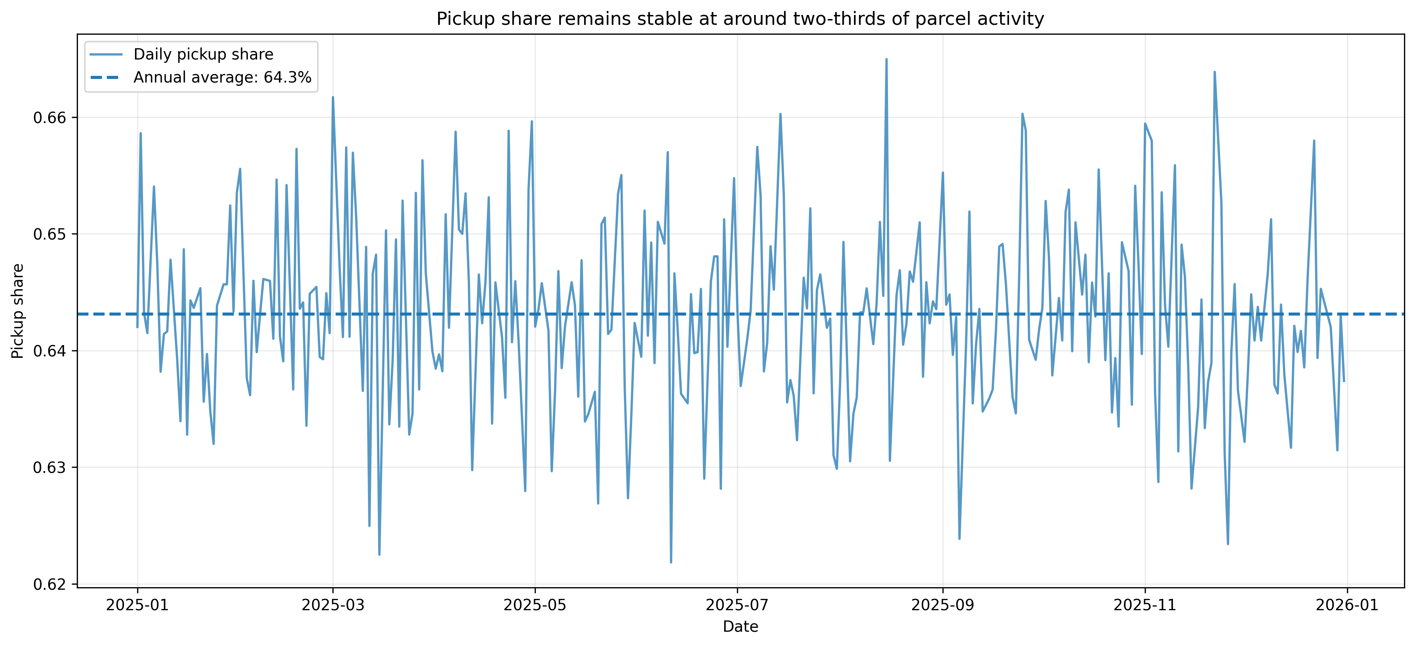
Demand is not evenly distributed across time
Weekday effects are important for daily capacity assumptions
Tuesday has the highest average parcel activity.
Sunday records no activity in the supplied data.
A weekday-based demand model is a stronger baseline than one annual average.
Capacity planning should use peak-day demand, not only average demand.
Pickup behavior is highly stable throughout the year
On average, 64.3% of all parcel activities are pickups
There is no clear seasonal trend in the pickup share
Business implication: Since pickups are much cheaper than deliveries, maintaining or increasing this pickup share is important for reducing total network costs.

Slide 5
2. Parcel volume is concentrated in a small set of service points
Current usage differs sharply across the 35 locations
Location 4440 is the busiest service point with 166,815 annual parcel activities.
Most locations are pickup-heavy, but some points have much lower pickup share.
Service point performance varies enough to require location-specific capacity assumptions.
Pickup/delivery ratios should be modelled by area, not assumed constant everywhere.

Slide 6
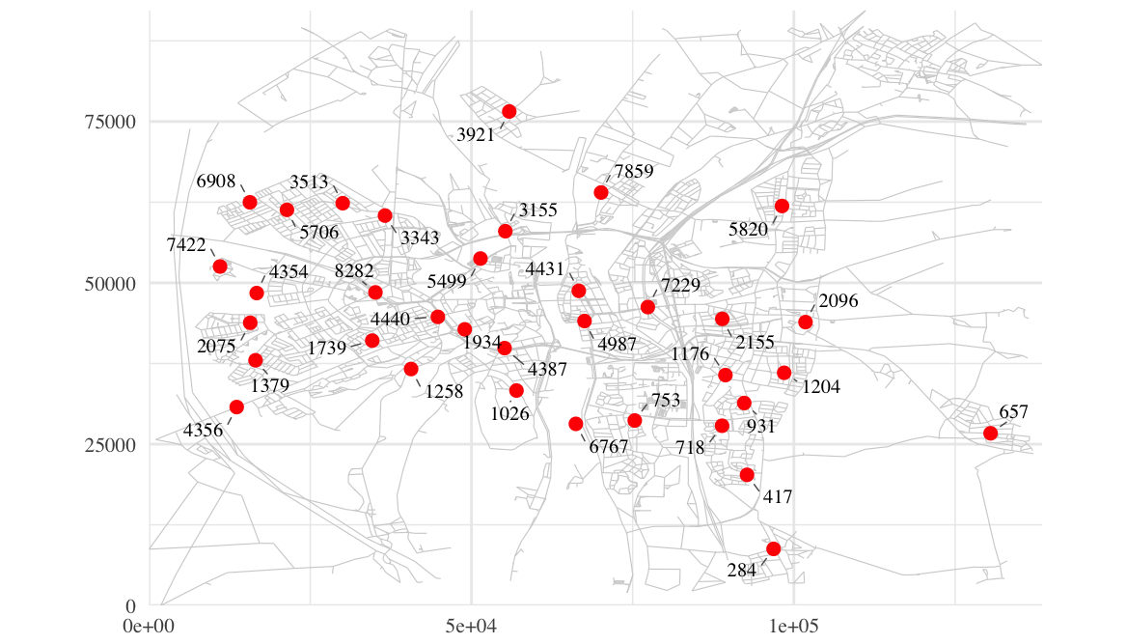
3. Geographic Distribution of Service Points
Where the current Maastricht service point network is located
Real map and service point locations
35
2025
service points
activity year
Main observation
•
Service points are concentrated in central and western Maastricht
•
Eastern and northern edges have fewer and more dispersed points
•
Location alone is not enough: need to compare with population and distance
Takeaway
•
Service point locations are not evenly distributed

Slide 7
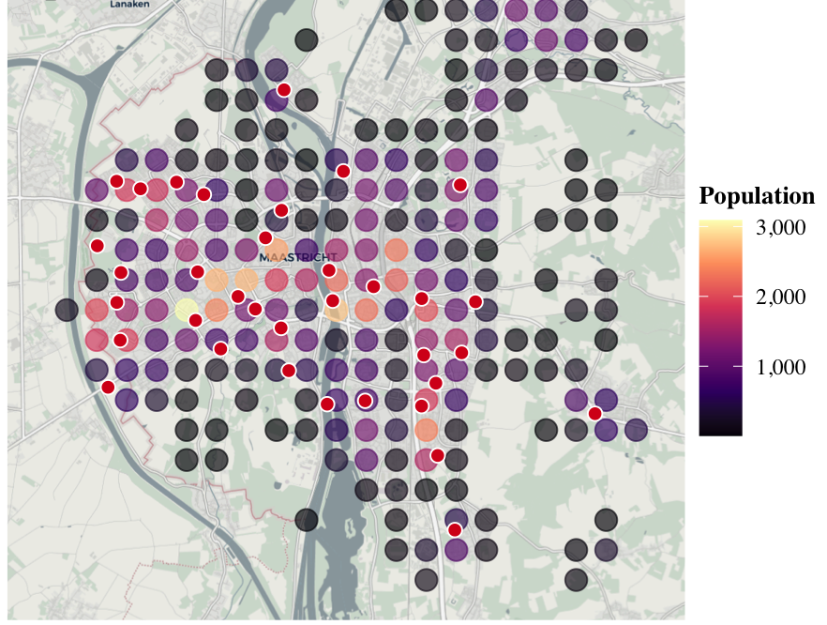
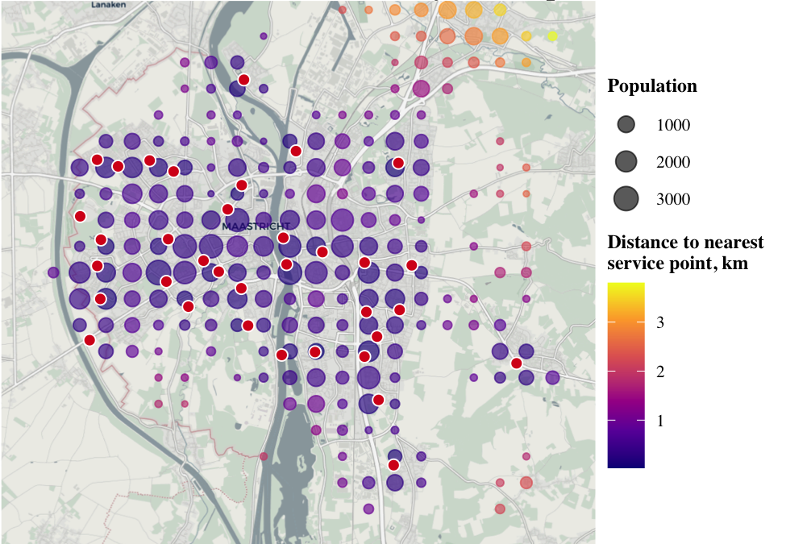
Population and Accessibility
CBS population squares show where demand potential is highest
Population distribution
Distance to nearest service point
Key takeaway
Most high-population CBS squares are close to an existing service point; longer distances mainly appear around peripheral areas.

Slide 8
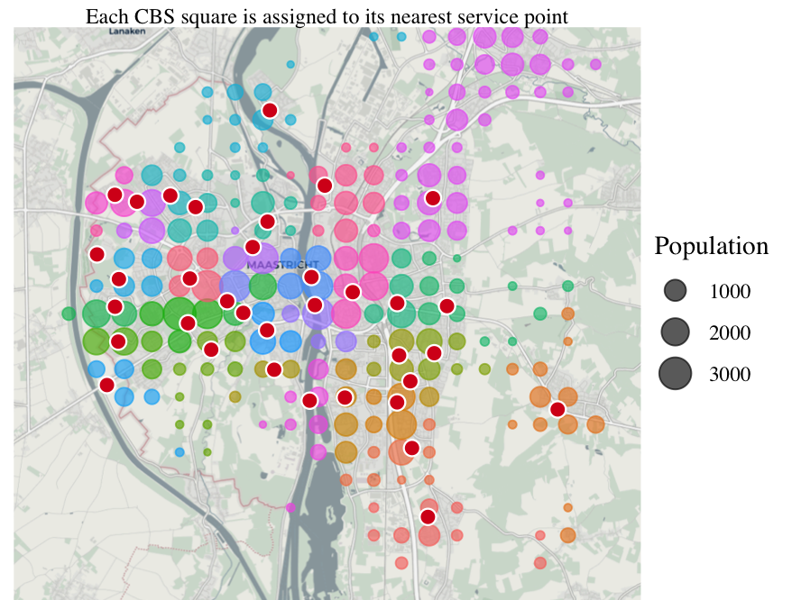
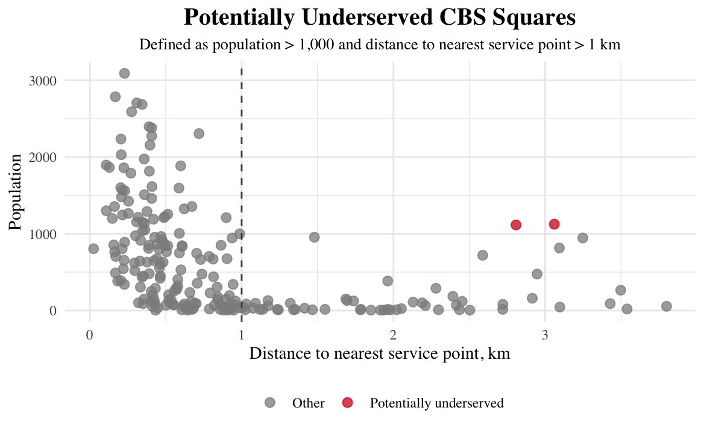
Underserved Areas and Catchments
Nearest-service-point assignment highlights where coverage pressure may appear
Estimated catchment areas
Potentially underserved CBS squares
1 km
>1,000
few
access threshold
population filter
candidate squares
Key finding
•
Coverage is generally strong for dense areas, but the catchment map shows uneven service areas. Peripheral CBS squares with longer distances are the main candidates for improvement.

Slide 9
4. CBS demographics provide demand-potential variables
Population is the cleanest anchor; detailed demographic fields need careful missing-value handling
Recommended primary variable: population per CBS square.
Useful extensions: households, age 25-44, urbanization/OAD and income bands.
Rows with no demographic data should be removed for spatial demand allocation.
Partial missing values can be imputed or excluded depending on modelling risk.

Slide 10
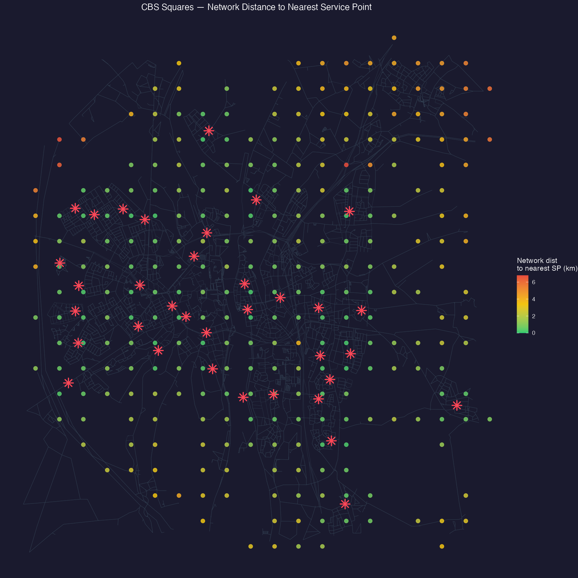
5. Distance explains accessibility and likely pickup behavior
Each CBS square is assigned to its nearest service point
Most high-population CBS squares are within 1 km of a service point
Distance drops significantly once population-weighted — remote squares are sparsely populated
A small but concentrated group of residents around SP 5820 face distances over 4 km
Population-weighted average distance is about 0.87 km.
92.8% of population CBS squares are within 2 km.
5.1% of population is over 3km away from nearest point.

Slide 11
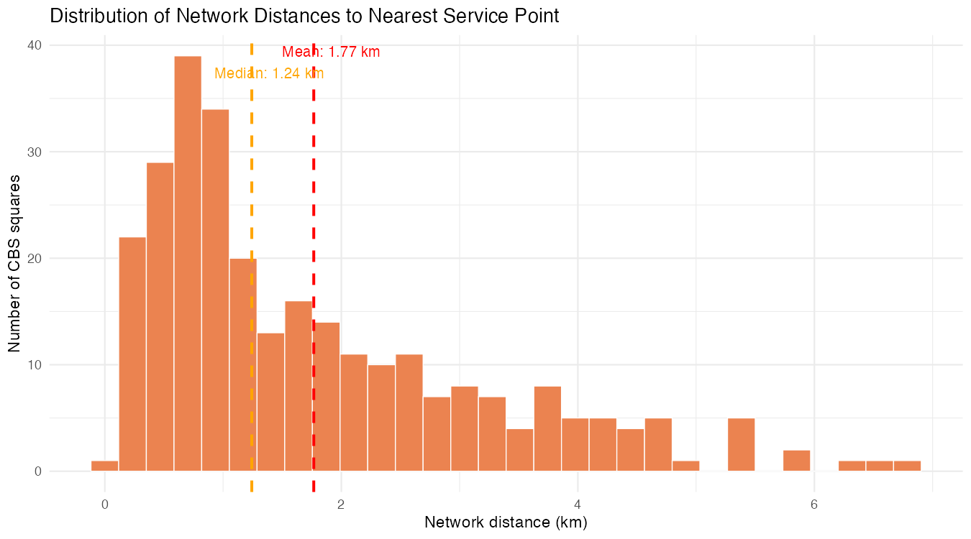
Distance distribution is right-skewed with a clear peripheral tail
Each CBS square is assigned to its nearest service point
Metric | Value
Mean network distance | 1.77 km
Median network distance | 1.24 km
Max network distance | 6.79 km
Within 1 km (squares) | 41.5%
Within 2 km (squares) | 66.2%
Over 3 km (squares) | 18.7%

Slide 12
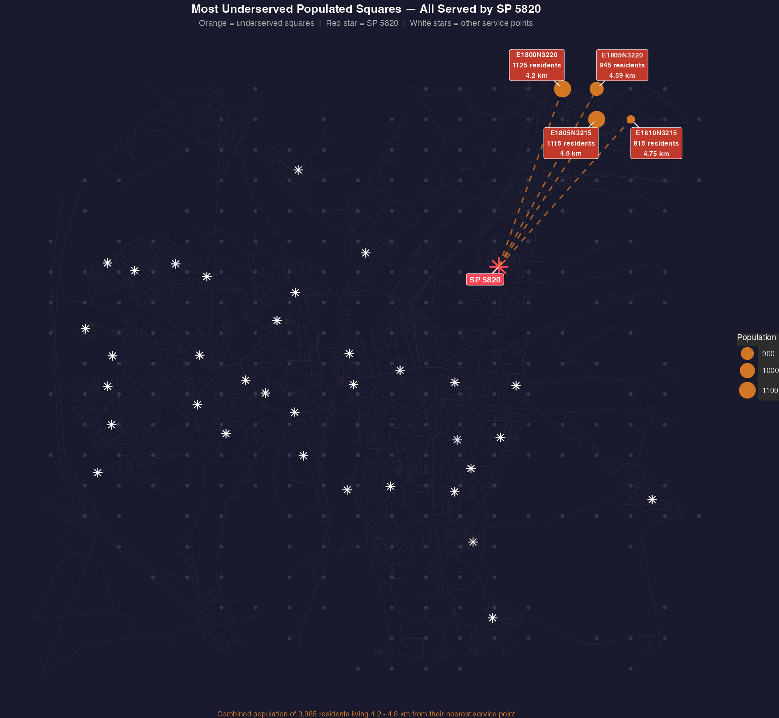
SP 5820 carries the heaviest accessibility burden
Each CBS square is assigned to its nearest service point
Square | Population | Nearest SP | Distance
E1800N3220 | 1,125 | 5820 | 4.20 km
E1805N3215 | 1,115 | 5820 | 4.60 km
E1805N3220 | 945 | 5820 | 4.59 km
E1810N3215 | 815 | 5820 | 4.75 km
E1800N3215 | 720 | 5820 | 3.68 km
SP 5820 serves squares up to 6.79 km away — the furthest in the network
Around 4,700 residents assigned to SP 5820 live more than 3 km away by road
Long distances reduce pickup probability

Slide 13
6. Cost and capacity translate EDA into business pressure
Translating parcel volumes and distances into euros and operational risk
The network runs 35 service points serving 1.35 million parcels per year at a total estimated cost of €2.55M annually
Fixed costs of €50,000 per service point dominate the budget at 69%, making the number of open locations the single biggest cost lever
Delivery cost varies by distance at €1.50 per km, concentrating cost pressure on service points with large or remote catchment areas
Capacity risk is real but predictable — every service point regularly hits double its average daily pickup load, with the network peaking at 5,270 pickups on December 2nd

Slide 14
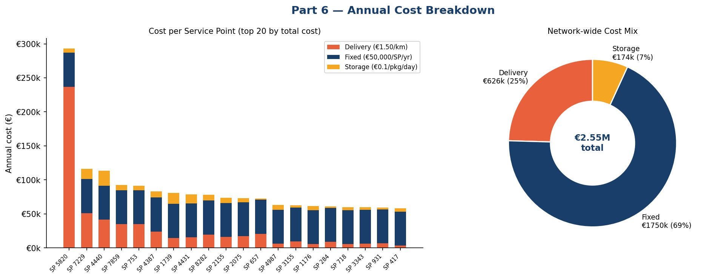
Annual Cost Breakdown
Fixed costs dominate (69%)
SP 5820 — cost outlier
Pickup saves €670k/yr
€1.75M of the €2.55M total is locked in regardless of volume — just 35 SPs × €50k.
2.47 km avg delivery distance → €237k/yr delivery cost alone vs. €6k network median.
Each pickup avoids €1.01 in delivery cost but adds only €0.20 in storage — a net €0.81 saving.

Slide 15
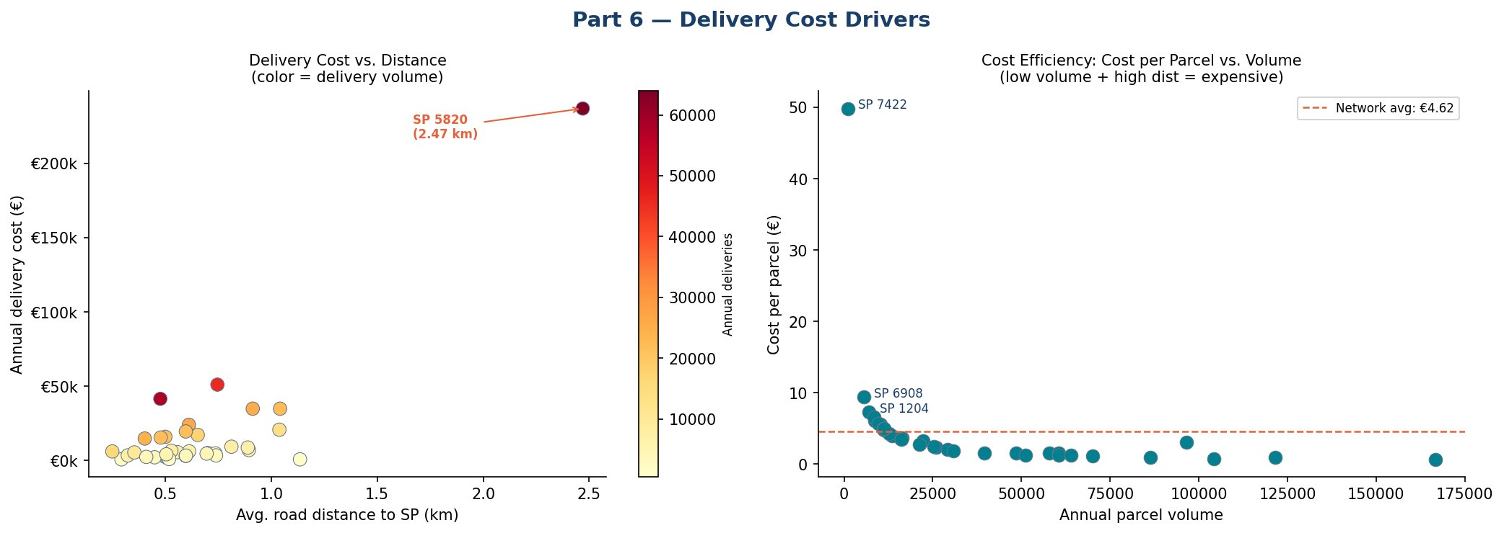
Delivery Cost Drivers
€49.83
€0.68
€4.62
2.47 km
Cost/parcel
(SP 7422)
Cost/parcel
(SP 4440)
Network avg
cost/parcel
SP 5820 avg
delivery dist
SP 7422 handles only ~1,000 parcels/year — the €50k fixed cost alone works out to €48.94/parcel, making it the primary closure candidate.

Slide 16
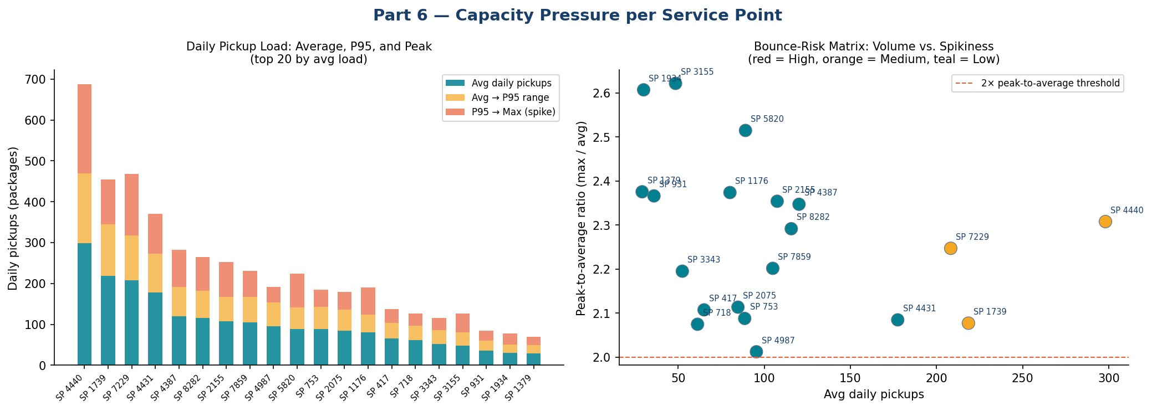
Capacity Pressure per Service Point
SP 4440 — clear hotspot
All SPs exceed 2× peak ratio
Medium-risk: 4 SPs
298 avg pickups/day, peaking at 688. On its worst day it handles 2.3× its typical load.
Every single SP in the network regularly experiences days at double its average — no location is immune to spikes.
SP 4440, 7229, 1739, and 7422 are the four medium-risk SPs. None yet reach High, but 4440 and 7422 are closest.

Slide 17
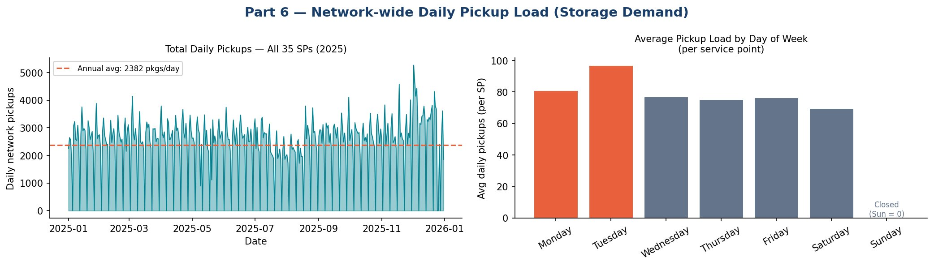
Daily Load & Weekday Patterns
December peak: ×2.2 avg
Tuesday is the busiest day
Network hit 5,270 pickups on Dec 2 — more than double the annual daily average of 2,382. Holiday capacity needs a 2× buffer.
97 avg pickups/SP — 27% above mid-week. Weekend online orders arrive Monday and are collected Tuesday.
Sunday = zero (closed)
Stable weekly rhythm
All 35 SPs are closed on Sundays. The zero bar is correct — no data issue. This creates a Monday build-up effect.
The weekly cycle is highly consistent year-round. Demand is predictable outside December, which makes capacity planning straightforward.

Slide 18
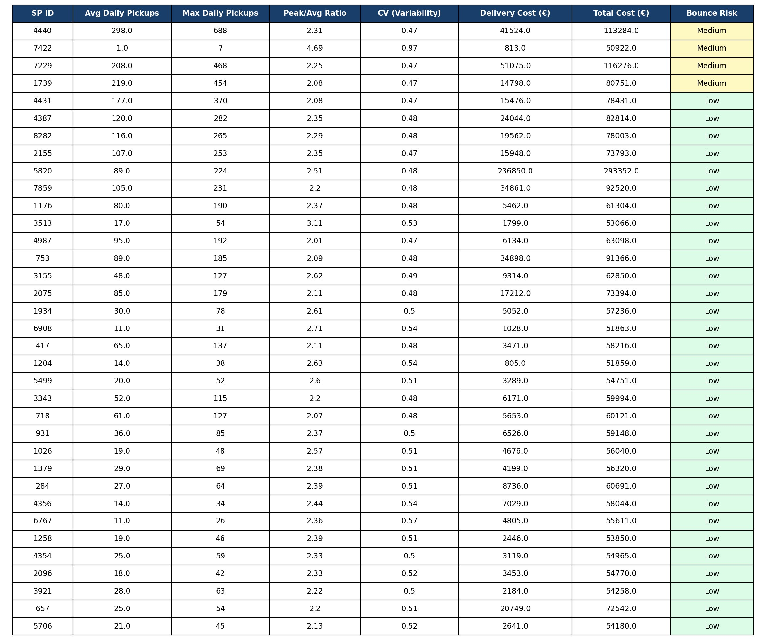
Bounce-Risk Ranking - All 35 Service Points
Score Components
50%
Volume
Avg daily pickups — high load = high risk
30%
Spikiness
Peak ÷ average ratio — unpredictable surges
20%
Variability
Coefficient of variation — erratic patterns
⚠ SP 7422: CV=0.97, peak ratio=4.69 — statistically extreme but only ~1 pkg/day average. Scores Medium due to variability despite near-zero volume.

Slide 19
EDA takeaways for the milestone
The six workstreams create one modelling foundation
Demand
Time
Service points
Maastricht generates about 3,704 parcel movements per day, with pickups representing 64.3% of activity.
Demand varies by weekday, so capacity assumptions should include peak-day patterns.
Current volume is concentrated: the busiest locations carry much more activity than the long tail.
Geography
Distance
Business impact
Main population concentrations are broadly covered, but peripheral access is less uniform.
Most high-population CBS squares are within 1 km; distance remains key for pickup probability.
Cost and capacity pressure should be evaluated per service point, not only city-wide.
Next step: convert EDA outputs into a shared optimization objective and compare solution methods on the same cost, distance, capacity and bounce metrics.

